Slide 1
Multiclass Classification
Sergey Ivanov

Slide 2
Plan
References
Presentation on Multiclass Classification
Error Rates and the Bayes Classifier
Gaussian and Linear Classifiers. Linear Discriminant Analysis. Logistic Regression;
Multi-class classification models and methods;
Multi-class strategies: one-versus-all, one-versus-one, error-correction-codes
Linear Classifiers and Multi-classification Tutorial
In-class exercise
Multilabel Classification format
Classifier Comparison
LDA as dimensionality reduction
LDA vs PCA
Logistic Regression for 3 classes
Linear models
LDA and QDA
Naive Regression
Cross Validation in Python

Slide 3

Naive Bayes
Notes:
http://scikit-learn.org/stable/modules/naive_bayes.html

Slide 4

Naive Bayes
Notes:
http://scikit-learn.org/stable/modules/naive_bayes.html

Slide 5
Naive Bayes
Notes:
http://scikit-learn.org/stable/modules/naive_bayes.html

Slide 6

Naive Bayes
Notes:
http://scikit-learn.org/stable/modules/naive_bayes.html

Slide 7

Naive Bayes
Notes:
http://scikit-learn.org/stable/modules/naive_bayes.html

Slide 8


Naive Bayes
Gaussian NB
Bernoulli NB
Notes:
http://scikit-learn.org/stable/modules/naive_bayes.html

Slide 9
Naive Bayes
Pros:
Fast
Prevent curse of dimensionality
Decent classifier for several tasks (e.g. text classification)
Inherently multiclass
Cons:
Bad estimator of probabilities to the class.
Notes:
http://scikit-learn.org/stable/modules/naive_bayes.html

Slide 10

Linear/Quadratic Discriminant Analysis (LDA/QDA)
Notes:
http://scikit-learn.org/stable/modules/lda_qda.html

Slide 11

Linear/Quadratic Discriminant Analysis (LDA/QDA)
Notes:
http://scikit-learn.org/stable/modules/lda_qda.html

Slide 12
Linear/Quadratic Discriminant Analysis (LDA/QDA)
LDA = each class has the same covariance equals to averaged covariance of the classes
QDA = each class has its own covariance
Notes:
http://scikit-learn.org/stable/modules/lda_qda.html

Slide 13
Linear/Quadratic Discriminant Analysis (LDA/QDA)
Pros:
Closed-Form solution
Inherently Multiclass
No hyperparameters tuning
Can be used as dimensionality reduction
Cons:
Assume unimodal Gaussian distribution for each class
Cannot reduce dimensions to more than the number of classes.
Not useful if “information” is in data variance instead of the mean of classes.
Notes:
http://scikit-learn.org/stable/modules/lda_qda.html

Slide 14

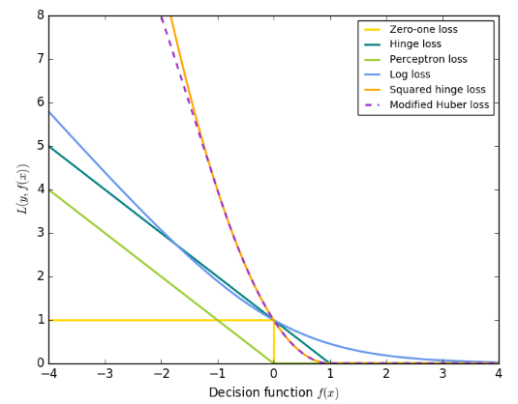

Stochastic Gradient Descent (SGD)
Loss functions L:
Notes:
http://scikit-learn.org/stable/modules/sgd.html#mathematical-formulation

Slide 15
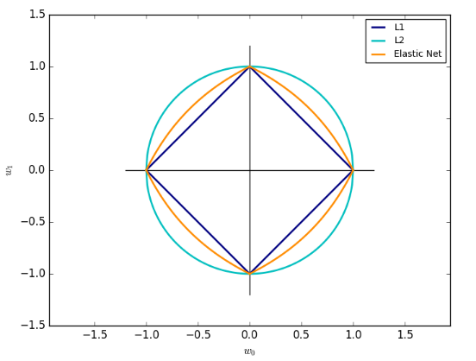

Stochastic Gradient Descent (SGD)
Regularization Term R:
Notes:
http://scikit-learn.org/stable/modules/sgd.html#mathematical-formulation

Slide 16


Stochastic Gradient Descent (SGD)
Notes:
http://scikit-learn.org/stable/modules/sgd.html#mathematical-formulation

Slide 17
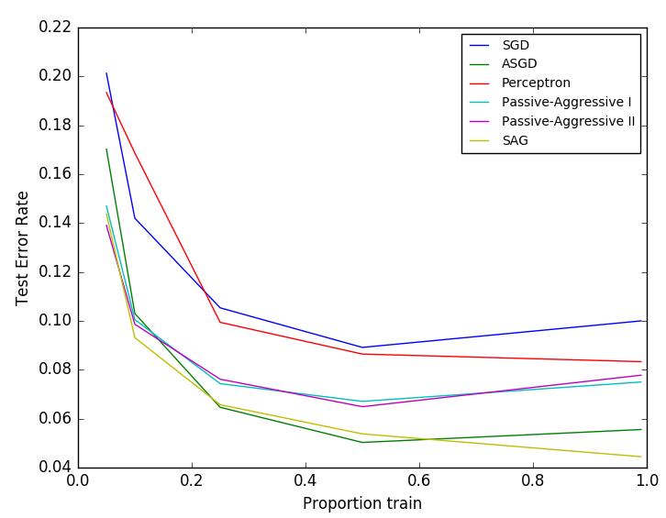
Stochastic Gradient Descent (SGD)
Notes:
http://scikit-learn.org/stable/modules/sgd.html#mathematical-formulation

Slide 18
Stochastic Gradient Descent (SGD)
Practical Tips:
Scale data so that each dimension has unit variance and zero mean. StandardScaler() in Python.
Empirically, n_iter = np.ceil(10**6 / n)
Averaged SGD works best with large number of features.
After PCA, multiply training data by c such that L2 norm will be equals to 1.
Notes:
http://scikit-learn.org/stable/modules/sgd.html#tips-on-practical-use

Slide 19
Stochastic Gradient Descent (SGD)
Pros:
Fast
Ease of implementation
Sound theoretical results
Cons:
Hyperparameters tuning
Sensitive to feature scaling
Not multiclass
Notes:
http://scikit-learn.org/stable/modules/sgd.html#mathematical-formulation

Slide 20
Multilabel and Multiclass classification
Multiclass: classifying more than 2 classes. For example, classifying digits.
Multilabel: assigning a set of topics to each sample. For example, assignment of topics to an article.
Multioutput-multiclass: fixed number of output variables, each of which can take on arbitrary number of values. For example, predicting a fruit and its color, where each fruit can take on arbitrary set of values from {‘blue’, ‘orange’, ‘green’, ‘white’,...}.
Notes:
http://scikit-learn.org/stable/modules/multiclass.html#multiclass-and-multilabel-algorithms

Slide 21
Multilabel and Multiclass classification
Inherent Multiclass: Naive Bayes, LDA/QDA, DT, Random Forest, kNN
One-vs-Rest
One-vs-One
Error-Correcting Output Codes
Notes:
http://scikit-learn.org/stable/modules/multiclass.html#multiclass-and-multilabel-algorithms

Slide 22
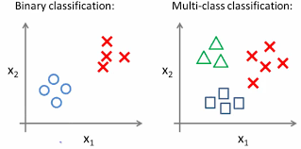
One-vs-Rest (OVR)
Notes:
http://scikit-learn.org/stable/modules/multiclass.html#one-vs-the-rest

Slide 23
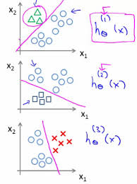
One-vs-Rest (OVR)
Notes:
http://scikit-learn.org/stable/modules/multiclass.html#one-vs-the-rest

Slide 24
One-vs-Rest (OVR)
Training: Fits one classifier per class against all other data as a negative class. In total K classifiers.
Prediction: applies K classifiers to a new data point. Selects the one that got a positive class. In case of ties, selects the class with highest confidence.
Pros:
Efficient
Interpretable
Notes:
http://scikit-learn.org/stable/modules/multiclass.html#one-vs-the-rest

Slide 25
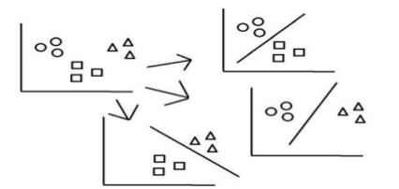
One-vs-One (OVO)
Notes:
http://scikit-learn.org/stable/modules/multiclass.html#one-vs-the-rest

Slide 26
One-vs-One (OVO)
Training: Fits (K-1) classifier per class against each other class. In total K*(K-1)/2 classifiers.
Prediction: applies K*(K-1)/2 classifiers to a new data point. Selects the class that got the majority of votes (“+1”). In case of ties, selects the class with highest confidence.
Pros:
Used for Kernel algorithms (e.g. “SVM”).
Cons:
Not as fast as OVR
Notes:
http://scikit-learn.org/stable/modules/multiclass.html#one-vs-one

Slide 27
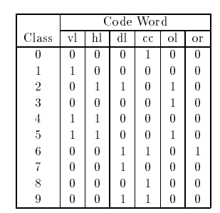
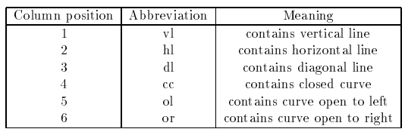
Error-Correcting Output Codes (ECOC)
Training: 1) Obtain a binary codeword for each class of length c. 2) Learn a separate binary classifier for each position of a codeword. In total, c classifiers.
Prediction: Apply c classifiers to a new data point and select the class closest to a datapoint by Hamming distance.
Notes:
http://www.jair.org/media/105/live-105-1426-jair.pdf
http://scikit-learn.org/stable/modules/generated/sklearn.multiclass.OutputCodeClassifier.html#sklearn.multiclass.OutputCodeClassifier

Slide 28
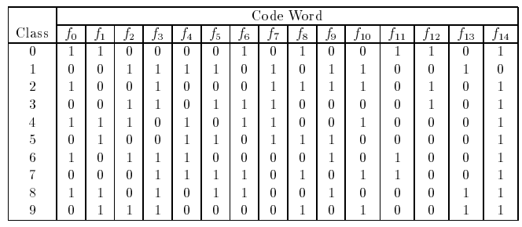
Error-Correcting Output Codes (ECOC)
How to obtain codewords?
Row separation
Column separation
Pros:
Can be more correct than OVR
Notes:
http://www.jair.org/media/105/live-105-1426-jair.pdf 7 page
http://scikit-learn.org/stable/modules/generated/sklearn.multiclass.OutputCodeClassifier.html#sklearn.multiclass.OutputCodeClassifier

Slide 29
Multilabel and Multiclass classification
Inherent Multiclass: Naive Bayes, LDA/QDA, DT, Random Forest, kNN
One-vs-Rest
One-vs-One
Error-Correcting Output Codes
Notes:
http://scikit-learn.org/stable/modules/multiclass.html#multiclass-and-multilabel-algorithms

